Slide 2
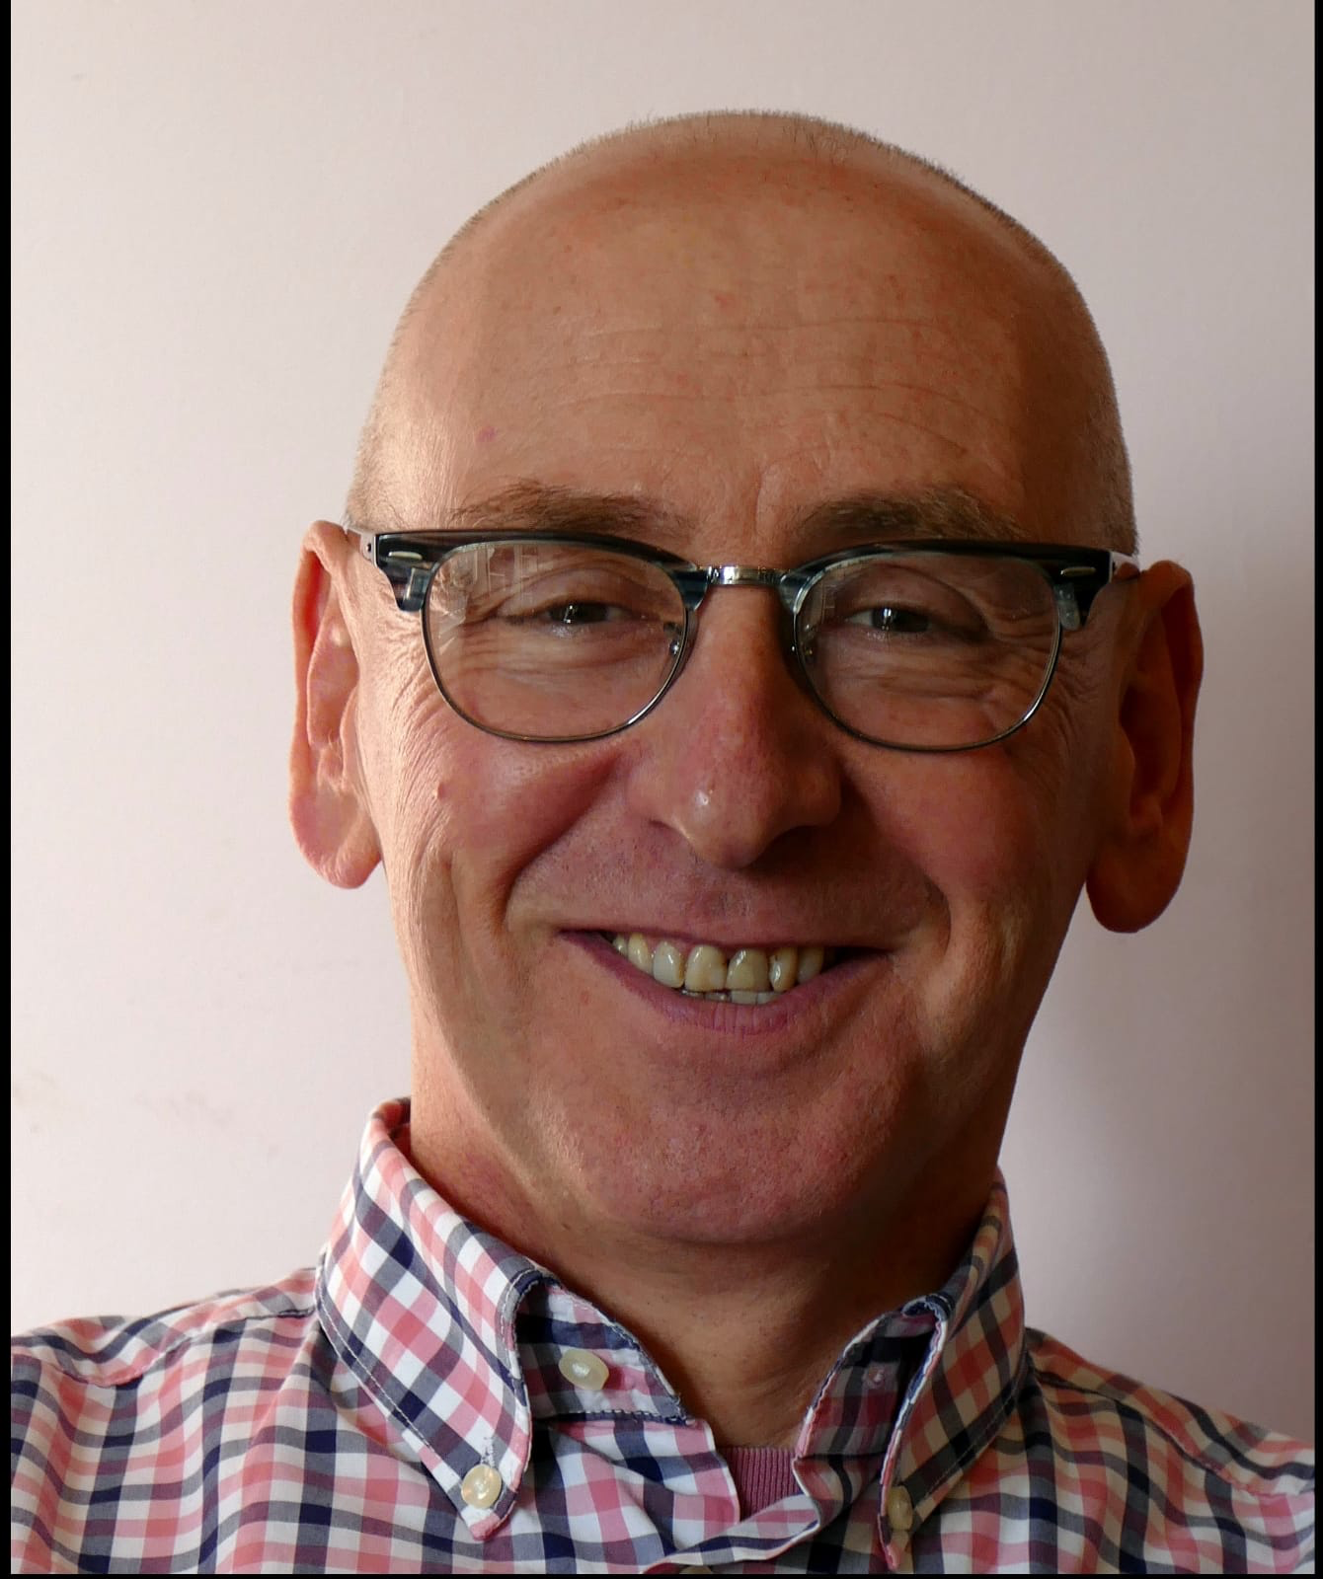
ANDREW JONES
Business Psychologist, Coach & Facilitator
Areas of Expertise
Executive and Leadership Development
Personal Development
Interview Skills
Customer Orientation
Mentoring and Coaching
Change Management
Sales Management
Culture Change
Creative Problem Solving
Appraisal and Feedback Skills
Performance Under Pressure
Personal Profile & Background
Andrew is a Business Psychologist, Coach and Facilitator, as well as being a core associate of the Emerge design and Delivery team. He has extensive experience of delivering to Emerge’s key clients and is able to develop strong and lasting relationships with them. Andrew’s career has seen him work internationally across several sectors, including finance, the public and private sectors and defence.
He has over 25 years of experience in Sales, Consultancy, Design and Delivery, training, management development and staff support programmes. Through his experience, Andrew is confident working with clients spanning from junior to board level roles.
After graduating Andrew worked for a large multinational oil company and held various roles in Marketing, Sales, and Commercial Management. He then spent time as a recruiter and a few years in career development and career transition services.
Professional Qualifications, Accreditation and memberships
Business Psychologist (Association for Business Psychology - Principle Practitioner)
MSc in Change Agent Skills and Strategies Encompasses a wide range of skills
ILM certified trainer and TPMA certified (Trainer Performance & Monitoring Association)
Member of International Association of Facilitators IAF
Qualified coach - EMCC and AfC member
Lumina Sparks Accredited
Insights Discovery Practitioner
Coaching Assignments
Financial Services – Global Director, increasing presence and self-confidence following promotion to a new position
City – CEO, developing a more flexible leadership style to achieve more from the team
Engineering – Senior Managers, developing management leadership and communication skill
Clients
• Alenia • Airbus • BBC • Walt Disney • Shell • RSA • Xchanging • AXA
www.emergeuk.com
01329 820580

Slide 3
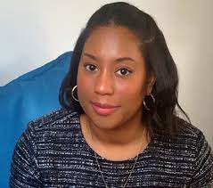
GABRIELLE FERGUSON
Coach & Facilitator
Areas of Expertise
Diversity and Inclusion
Belonging and Connectivity
Team Management
Employee Engagement
Management Development
Coaching
Women Returners and Women in Leadership
Leadership Development
Personal Profile & Background
Gabrielle is a vibrant and energetic person, with a positive approach towards coaching and consulting. Throughout her whole life, she has had a fascination with what makes people ‘tick’ , which is what led her coaching and motivated her to gain a formal qualification as a coach.
Gabrielle is qualified in both HR and project management her background lies in leading and driving programmes to support positive change in the areas of performance and talent management, succession planning, employee engagement, learning and development, internal communications, and inclusion & diversity.
Her passion is for developing and accelerating the careers of talented individuals, and always with an inclusive lens. Gabrielle is skilled at establishing good working relationships quickly, building rapport and creating a safe space enabling open, empathetic and authentic conversations. She has a way of making people feel comfortable talking about complex areas of EDI in order to learn how to phrase things differently or to change their behaviour.
Professional Qualifications, Accreditation and memberships
MA in Human Resources Management
BPS Level A and B Certified
Hogan Suite Inventories certified (HPI, HDS, MVPI)
Mental Health First Aiders
Everything DiSC
Neethling Brain Instrument (NBI) Practitioner
MBTI Step 1 Certified
Certified Project Management Associate (APM)
Level 5 Coaching Diploma, Accredited IAPC&M
Coaching Assignments
Higher Education – coached Associate Director to promotion, manage change and kickstart transformation to raise standards.
Financial Services – coached introverted Head of Legal to embrace an authentic leadership style.
Insurance – coached Head of Claims back from parental leave into promotion, on confidence, managing transitions and building team.
Clients
Talogy
ITV
Korn Ferry
NHS
Amazon
Kings College London
www.emergeuk.com
01329 820580

Slide 4
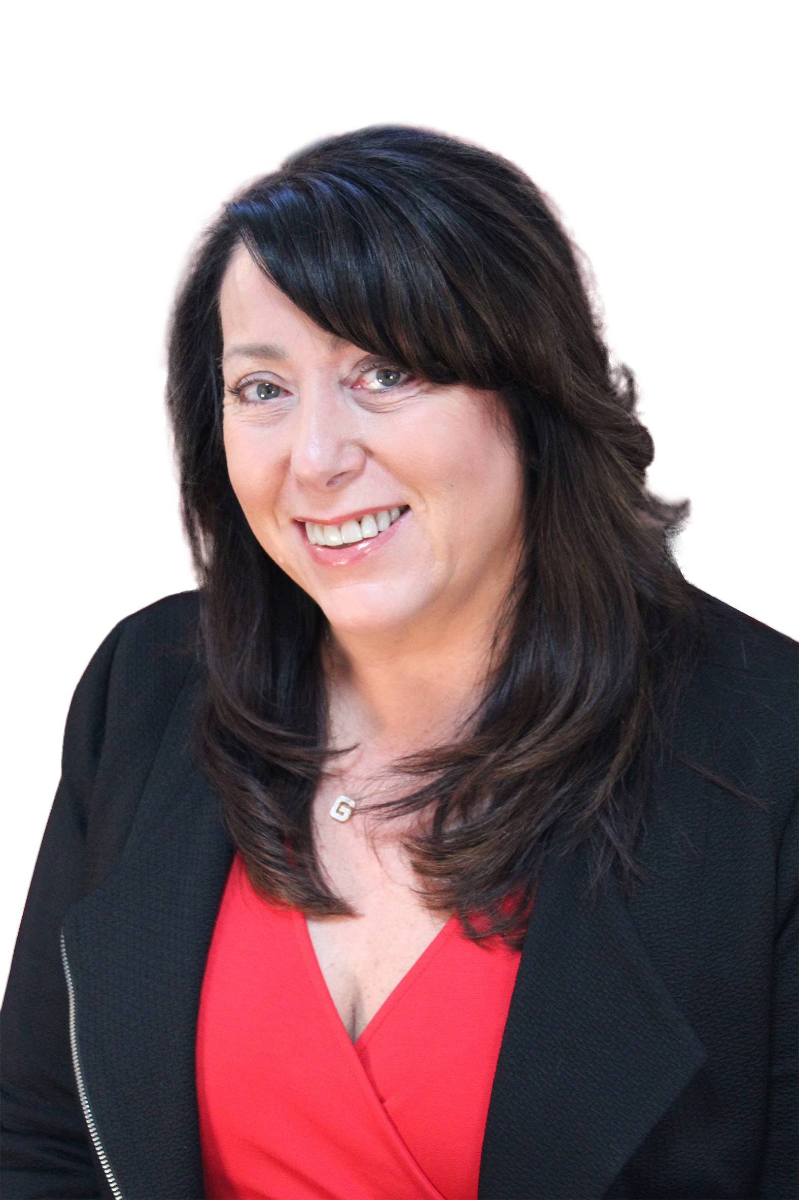
GILLIAN JONES-WILLIAMS
Author, Managing Director, Executive Coach, Motivational Speaker
Areas of Expertise
Executive coaching
Coaching culture Strategy
Leadership Development
Organisational Change
Board Support and “repair”
Equality, Diversity & Inclusion
Visioning and Strategy
Women’s confidence coaching programmes
HR Team Development
Coaching people who are perceived to have “bullying” behaviour
Personal Profile & Background
Gillian Jones-Williams is an , founder and Managing Director of Emerge Development Consultancy which she founded 30 years ago. Her understanding and application of psychology, hypnosis and Neuro Linguistic Programming allows her to build deep rapport and achieve outstanding and lasting behavioural changes with individuals and groups.
Gillian is an expert in Inclusivity and Diversity having spent the last 9 years working with organisations to help them implement their D&I strategies.
As an author Gillian has published ‘50 Top Tools for Coaching’ which is now on its 5th edition. Gillian is an expert in organisational culture change and ‘How to Create a Coaching Culture’ is in its 2nd edition.
Gillian developed the Women’s Development programme RISE which is delivered in the UK, UAE and USA.
Gillian has an energetic, confident and humorous personality and is naturally inquisitive, direct and focused. She is highly experienced at helping people to identify ‘blind spots’ through giving objective and insightful feedback that ensures they feel empowered to make changes. Her focus in sessions is ensuring that the ‘real issue’ has been identified and that people are accountable for actions agreed. It is vital to Gillian that she enables clients to feel empowered and ready to take responsibility/ownership of the issues discussed.
Coaching Assignments
Coaching Women to prepare for the next role by eliminating Imposter Syndrome and increasing confidence
Coaching directors in global organisations to manage multiple stakeholders
Coaching Managing Directors and facilitating executive meetings to increase personal and organisational effectiveness.
Executive Board “repair” and improvement
Coaching leaders to develop Emotional Intelligence and Leadership Style
Professional Qualifications, Accreditation and Memberships
Training and Development Lead Body Level 3 + 4 Certificate in Business Coaching
Diploma in Performance Coaching
Neuro Linguistic Programming Diploma
Neuro Linguistic Programming Practitioner
Diploma in Hypnosis
ILM Level 3 Coaching & Mentoring
ILM Level 5 Certificate in Coaching & Mentoring
AC Accredited Master Executive Coach
MBTI™ Practitioner
Motivational Maps™ Practitioner
Member of the Association for Coaching (AC)
Clients
• Airbus • BAE Systems • BBC • Crown World Wide • Harper Collins • Mitsubishi • Channel 4 • ECB • Scottish Rugby Union • Conde Nast • KFC • ESI Media • Hilton Hotel Group •Jaguar Land Rover • Visa Europe
www.emergeuk.com
01329 820580

Slide 5
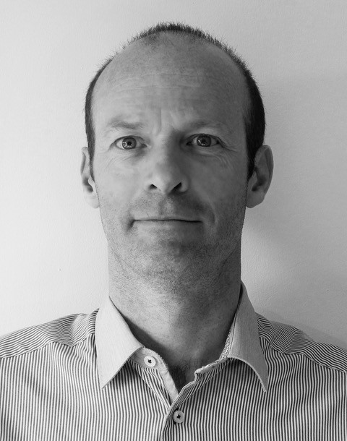
IAN WILSON
Coach & Facilitator
Areas of Expertise
Training programmes
Design
Experimental Training
Leadership Management
Coaching
Learning conferences
Personal Profile & Background
Ian Wilson has over 26 years’ experience in the field of learning and development, including coaching individuals, teams, and coach training for managers. His work has included full-time work for an NGO and a large international training company. Additionally, he has spent over a decade as an independent consultant.
Ian is a high-level coach for white-water kayaking and rock climbing. He uses his experience in this area to strong effect through goal setting, performance review and high performance.
Through international work with many nationalities, as well as living in France, Ian has a strong affinity with intercultural groups and second language speakers. He has developed a clear and concise style that does not rely on the complexity and nuances of language that non-native English speakers sometimes find challenging.
Ian has a relaxed, friendly questioning approach, quickly establishing rapport with clients. Coaching clients can expect to be challenged and held accountable for action plans and follow up, but this is always done in a supportive and non-judgemental way.
Professional Qualifications, Accreditation and memberships
ILM Level 7 Certificate in Executive Coaching and Mentoring
Coach Practitioner (INLPTA)
BA (Hons) Management (2.1)
Transactional Analysis TA 101
MBTI Step 1 & 2 Certified
PPA (DISC) certified
NLP Practitioner (ABNLP and INHNLP)
Emotional Intelligence training (JCA)
Certified Business Communications Practitioner
Clients
Airbus
RBS
Deutsche Bank
Jaguar Land Rover
Deloitte
Sofinco
INSEAD
African Development Bank
Credit Agricole
Coaching Assignments
Emotional Intelligence based experiential programme for UAE government department in conjunction with a top business school.
Graduate induction event using experiential learning activities (such as Community projects) to develop self-awareness, team and leadership skills.
www.emergeuk.com
01329 820580

Slide 6
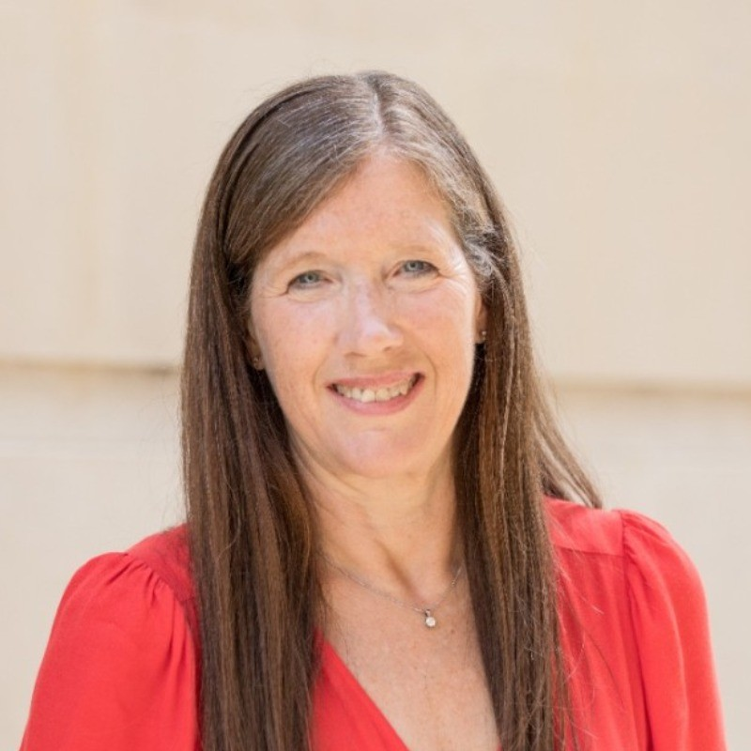
JACKIE ADAMS
Coach & Experienced HR
Professional
Areas of Expertise
Coaching
Facilitation
HR Consultancy
Transition and Career Coaching
Team Development
Use of psychometrics
Personal Profile & Background
Jackie is a qualified and accredited executive coach with experience coaching a variety of individuals. She has a challenging, but supportive solution focused coaching style.
Jackie is an experienced HR professional, having held senior level roles within a variety of FTSE 100 companies. She has supported business leaders and managers in a variety of challenges, which include carrying out disciplinary investigations, appeals and grievances, restructures, and redundancy consultations. She has also run reward processes and implemented talent review and succession planning processes.
Jackie also has a deep knowledge of the Education Sector, having been a school governor for 10 years as well as spending 11 years as a Trustee of GLF Schools (a multi-academy trust of 40 schools).
Jackie has a warm and empathetic style, with great listening skills and a non-judgemental approach, and is able to build rapport and develop relationships quickly and effectively. She help clients to challenge their thoughts and behaviours, giving them space to reflect and consider options, and then enabling them to decide on next steps.
Professional Qualifications, Accreditation and memberships
MA Employment Law and Employee Relations
CIPD Advanced Certificate in Reward Management
Towers Watson Reward Leadership Programme
AoEC Practitioner Diploma in Executive Coaching (affiliated with Middlesex University)
British Psychological Society – Qualified at levels A&B
BA Home Economics and Social Administration
Myers Briggs (Steps I and Step II)
Hay Job Evaluation
Investigations Training (Baker & McKenzie LLP)
Qualified to use Psytech International psychometric tools, including 360 feedback
Coaching Assignments
Finance – coaching CEO of a major online investment service leading his company into overseas expansion and significant global growth.
Education – Executive Head Teachers, enhancing perspective and energy levels, focusing on how to ‘achieve more with less’.
Clients
Jackie has worked with clients from a variety of industries including:
Finance
Education
www.emergeuk.com
01329 820580

Slide 7
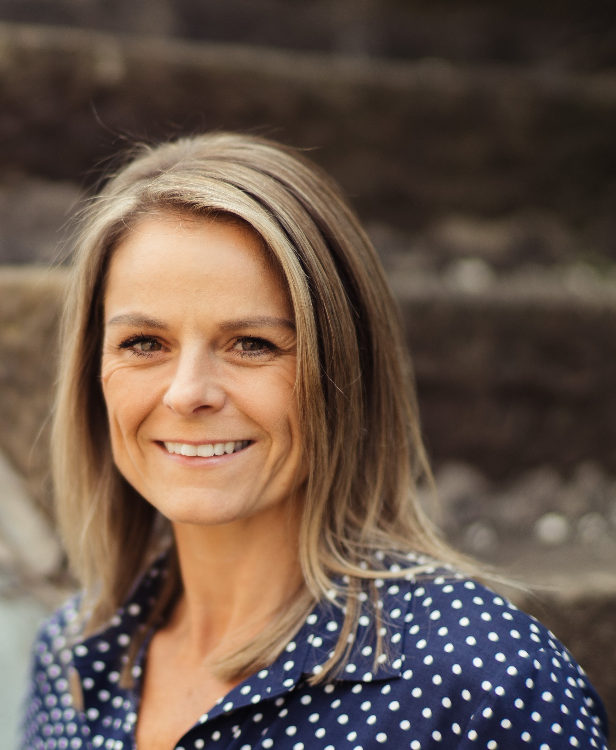
JANE VILJOEN
Coaching Psychologist & Executive Coach
Areas of Expertise
Communication
Emotional Intelligence
Leadership
Succession Planning
Career Development
Psychological Safety
Wellbeing and Brain Based Behaviour Change
Personal Profile & Background
Jane is a Multi-Award-Winning Coaching Psychologist and the only Executive Coach in the UK qualified with her unique credentials. She is also a member of EMCC member and founding member BPS Special Group of Coaching Psychologists.
A member of Forbes Coaches Council, she has a strong affiliation to positive psychology and an expertise in helping people to reach their potential. Jane utilises the practice of Conversational Intelligence™ which uses emerging research from neuroscience to increase challenge, engagement and to build organisational and interpersonal trust, as well as using practical and accessible psychological content to help leaders and teams excel.
Jane’s psychological background gives her an in-depth understanding of approaches and a robust breadth of knowledge to decide which techniques are most appropriate for each professional client. She is deemed an expert in Emotional Intelligence and Resilience having completed research in these areas and designed and delivered products relating to them.
Jane has completed thousands of hours of coaching in private, public, business and financial sectors.
Professional Qualifications, Accreditation and memberships
MSc Occupational Psychology
BSc (Hons) Psychology and Health
Special group of Coaching Psychologists (BPS)
Post Graduate Coaching Certificate
Enhanced Practitioner of Conversational Intelligence for Coaches™
Solution Focused Brief Therapy and Coaching
Qualified in measurement of Emotional Intelligence (JCA EIP)
JCA toolkit accredited
360 Feedback Qualification
CSL 360 Accredited
16PF Assessment qualified
Level A and B Psychometric
Assessment and Testing
Person Centred Consultancy and Coaching
Coaching Assignments
Finance – coaching CEO of a major online investment service leading his company into overseas expansion and significant global growth
Education – Executive Head Teachers, enhancing perspective and energy levels and how to ‘achieve more with less’
Clients
Boehringer Ingelheim
Sony Pictures
HMRC
Business Coaching Academy
www.emergeuk.com
01329 820580

Slide 8
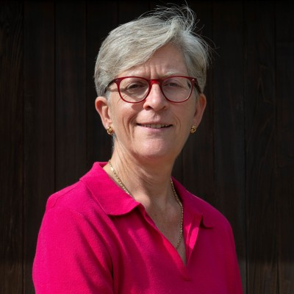
JENNY CRIDLAND
Business Mentor, Executive Coach, Leadership Development Expert
Areas of Expertise
Leadership Development
Mentoring
Human Resources
Team performance
Personal Effectiveness
Resourcing
Talent Management
Coach mentoring
Personal Profile & Background
Jenny has enjoyed a successful career as a Senior Leader in Human Resources, working in a variety of complex, global, high technology FTSE 50 organisations. Now an independent consultant and qualified coach, she supports a number of clients and individual business leaders.
Jenny has worked with global teams across Europe, the USA, India, the Middle East, and Australia recruiting senior leaders and individuals with scarce skills. Her focus was to develop best practice development and mentoring programmes designed to retain and grow key talent and improve business, team, and individual performance.
Jenny is passionate about developing others and has designed and delivered several organisation-wide strategic leadership development programmes. Additionally, she is a Honorary Teaching Fellow at Lancaster University as part of the University Leaders in Residence programme. Her extensive business experience allows her to help clients understand the politics of an organisation and how to manage multiple stakeholders.
Jenny manages to combine a pragmatic and focused approach with humour and insightful questions that get to the nub of an issue quickly and shifts thinking and perspectives. Her skill in listening ensures that she gets quickly to the heart of issues.
Professional Qualifications, Accreditation and memberships
BA (Hons) Business Administration, Management and Operations
MBA
FCIPD
FRSA
EMCC Coach Practitioner EIA
Clients
Be the Business
BAE Systems
University of Strathclyde Business School
University of Bath Business School
Qinetiq
British Heart Foundation
Coaching Assignments
Be the Business - Leading a national programme to help 100’s of SME leaders to improve their productivity through a focus on employee engagement and better workplace practices. Resulted in a £250m government investment in a national leadership development programme for small business leaders.
Defence – Development of a mentoring programme which ensured the development of key talent.
Defence – coaching teams of people following attendance on leadership programmes
www.emergeuk.com
01329 820580

Slide 9
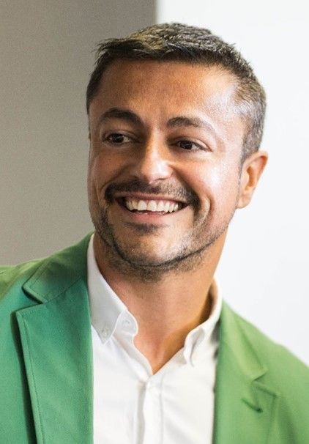
JOHN ATHANASIOU
Senior Level Director of
People, Executive Coach &
Board Advisor
TEAM TRAINING FACILITATOR
Areas of Expertise
Cultural and behavioural change
Personal and team effectiveness
People culture
Talent development
Diversity, Equity and Inclusion
Team Management
Leadership
Human Resources
Personal Profile & Background
John is a Senior Level Director of People and Executive Coach with over 25 years of experience in People Strategy, Leadership Development, cultural and behavioural change. His first-hand experience of the issues that leaders and management can face enables him to support leaders and businesses to improve personal and team effectiveness for higher commercial performance.
John actively believes in the power of people to learn, grow and change. His ultimate passion is to help deepen self-awareness, clarifying his clients' individual goals and maximising their potential for happiness and success in both their career and life.
His coaching style is supportive, whilst challenging of limiting beliefs, and paradigms that hold people back. John prioritises establishing rapport, trust and immersing himself in the issues facing his client to build an approach that will allow clients to access their goals and ambitions. He has a strong intuition that often leads people to think about things very differently.
Professional Qualifications, Accreditation and memberships
BA (Hon) Finance
MA Human Resources Management
Chartered Institute of Personnel and Development
ILM Level 5 Coaching
Myers Briggs Practitioner
Hogan Personality Profile Practitioner
NLP Fully Qualified
Belbin Team Dynamics Practitioner
SHL Level A & B in Personality Profiling
Coaching Assignments
Publishing - Providing advice and coaching to the CEO, supporting him navigate issues and lead his Executive team of 12 to be a high performing team.
Publishing - Created several comprehensive leadership programmes for high potential individuals across the business
Television - Partnered with regional business leaders and human resource professionals to support enterprise-wide initiatives including internal mobility, workforce diversity, talent management and succession planning.
Clients
John has worked with clients from a variety of industries including:
Media
Retail
Education
Public Sector Services
www.emergeuk.com
01329 820580

Slide 10
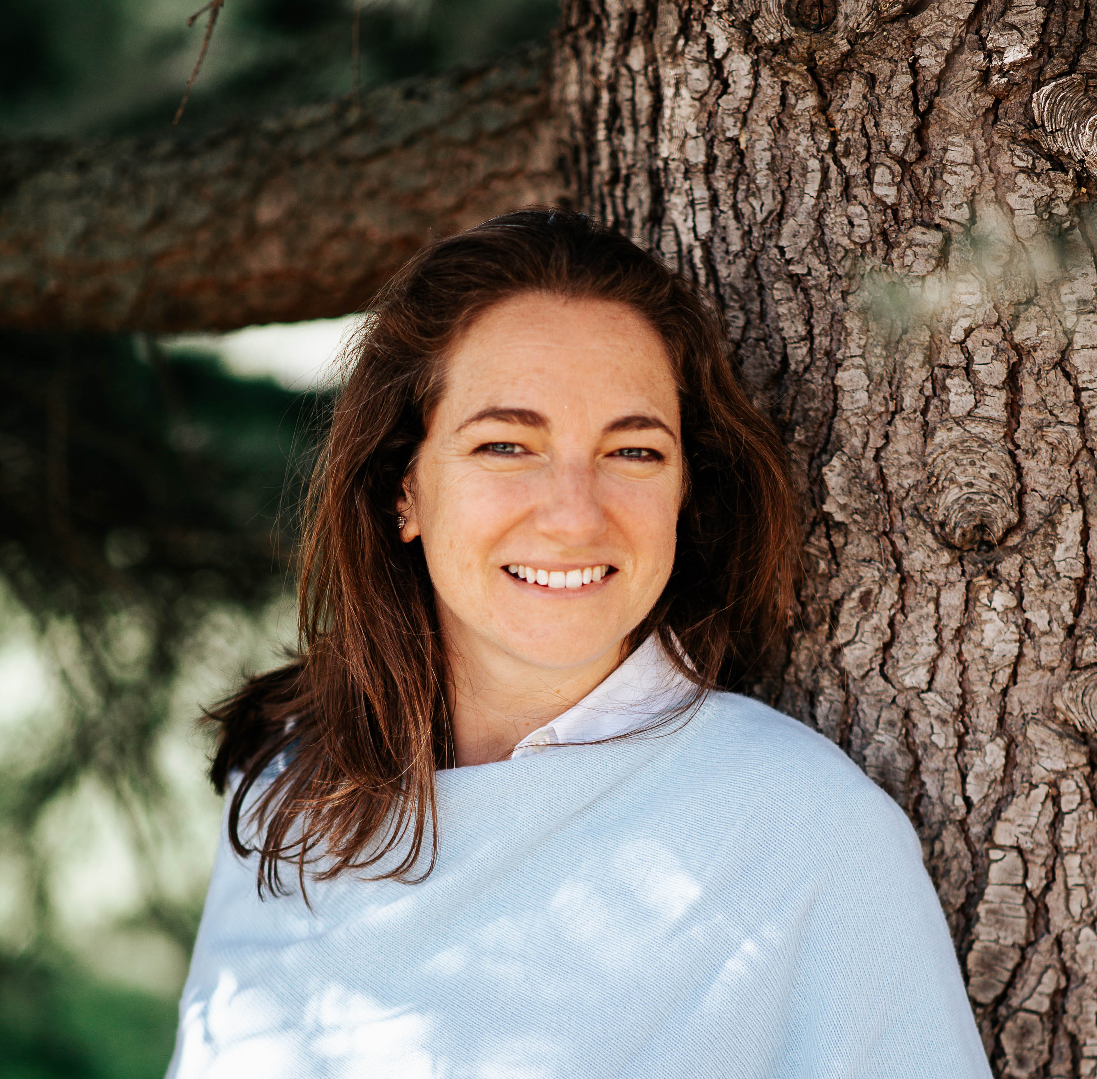
KATE GONDOUIN
Transformational Coach/ Facilitator
Areas of Expertise
Recruitment
Career Development
Wellbeing and Stress Management
Change and Communication
Personal Effectiveness
Project and Programme Management
Menopause
Maternity and Parenting
Personal Profile & Background
Kate is an experienced Facilitator and Transformational Coach specializing in International HR, Project and Change Management. With a focus on recruitment, talent development, cultural change and business transformation, she consistently delivers tangible results and fosters enduring employee engagement within teams and organisations.
With over 25 years of experience, Kate brings a wealth of experience, working with clients internationally. She is always learning and supporting others to become better, more truly-aligned version of themselves to excel personally and professionally. She capitalizes on her life experiences to authentically relate, connect with and support others wherever they are in their life and career.
Kate has also served as a TEDx Speaker Coach and is an invited guest on podcasts and global summits. She generously shares her expertise on diverse topics including careers, cross-cultural relationships, parenting and international living and working.
Professional Qualifications, Accreditation and memberships
EMCC Global EIA Practitioner Coach & Mentor
Ultimate Self Mastery – 12-month Mastery Level (Peter Sage)
Narrative Practices in Coaching
Existential Coaching
Positive Psychology
Group Coaching & Facilitation
Parents@Work Ambassador
BSc Business and Financial Services – University of Manchester
BA Natural Sciences – University of Cambridge
Clients
Kate has worked with clients from a variety of industries including:
Airbus
Atrium HR International
Airbus Beyond
Coaching Assignments
Coaching professional women to manage imposter syndrome and increase confidence.
Coaching international career changers to believe in themselves, excel in interviews and secure the promotions they thought impossible.
Coaching menopausal return-to-work women to believe in themselves, their value and their contribution to work and society.
www.emergeuk.com
01329 820580

Slide 11
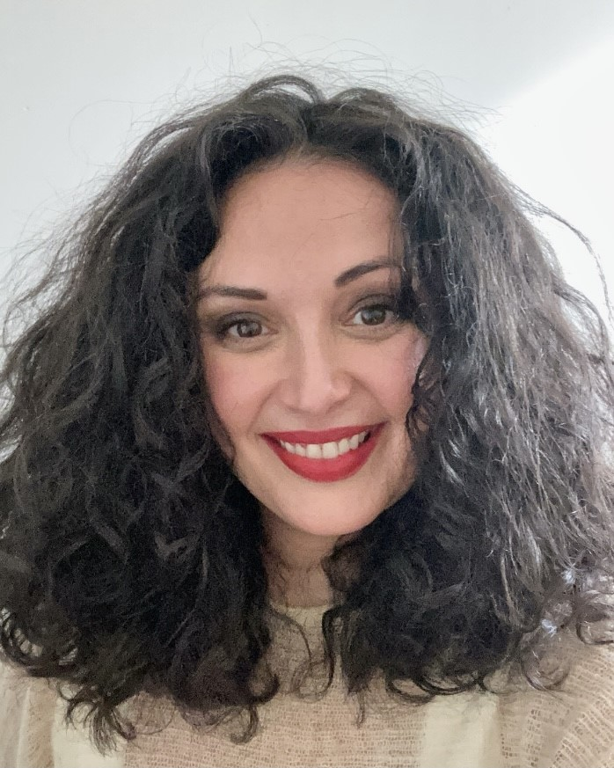
LARA KHALAF
Executive Coach, Women’s Development and Feminine Leadership Expert
Areas of Expertise
1:1 Personal and Executive Coaching
Workshop Facilitation
Public Speaking
Conferences
Moderation
Women’s Development
Personal Profile & Background
Lara’s life work is in service to women and the feminine; as a Women’s Empowerment, Feminine Leadership Specialist and Medicine Woman her work centres around guiding, empowering, and elevating women to become more confident, connected and conscious feminine leaders at the level of head and heart.
Lara has had over 20 years of international experience, managing large team operations in the private, corporate, and public sectors. Then, in 2015 she decided to shift her career, becoming a professional coach. Lara worked as an in-house Coach and Head of L&D for a large department in a Swiss investment bank before launching her own boutique conscious coaching business, which is firmly focused on women’ development.
Amongst other accomplishments Lara is a NED for care home in Spain, has won multiple awards, including the 2019 Women Economic Forum “Exceptional Woman of Excellence”. She has delivered a TEDx talk called “the other side of Syria”, has spoken internationally on topics related to women’s empowerment, runs a podcast named “She who rises up” and blogs for Psychologies magazine, where she is also part of its Coach’s directory.
Her method of work utilises various modalities and frameworks, which she has acquired throughout her own journey of expansion such as ancient feminine wisdom, embodiment integration, cyclic living, belief systems reprogramming, and more. In her core she remains a philosopher, mystic, and messenger of love.
Professional Qualifications, Accreditation and memberships
Reiki Practitioner
Menopause Wellbeing Practitioner
Menstrual Cycle Practitioner
ACC – International Coach Federation
Master Practitioner of Neuro Linguistic Programming
Postgraduate in Personal and Business Coaching (ICF)
MA in Arabic Philology
Clients
Lara has worked with clients from a variety of industries, including:
Insurance brokerage
Entertainment and Media
Marketing
Technology
Government
Healthcare
Coaching Assignments
Media – Aided Director in bringing clarity and strategy in a wholistic way to business approach.
Wellness – Supported CEO in reconnecting to herself, bringing balance and heightened self-awareness to support achieving business and personal goals.
Coaching numerous women on limited beliefs and increasing confidence
www.emergeuk.com
01329 820580

Slide 12
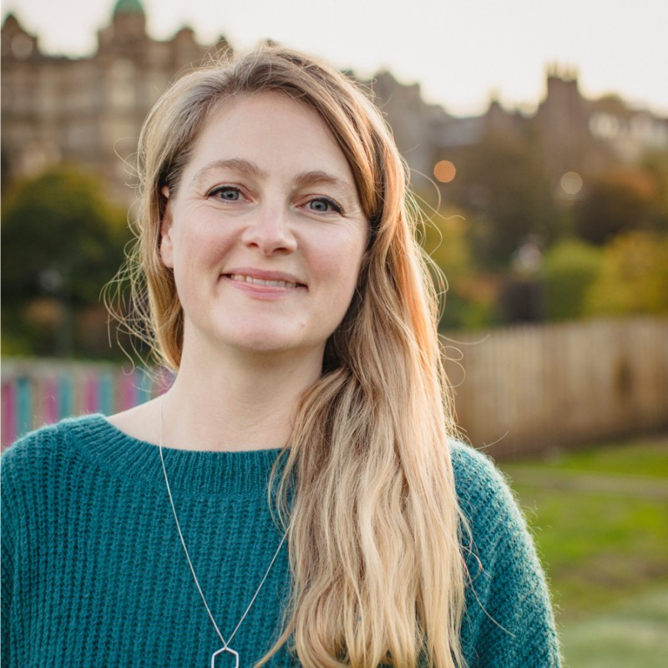
ROSIE ARTHEY
Neurodiversity Specialist & Coach
Areas of Expertise
Neurodiversity
1:1 Coaching
Group workshops and training
Diverse people-focused business
Mentoring
Personal Profile & Background
Rosie is an experienced and enthusiastic mentor, coach and facilitator who specialises in Neurodiversity. Rosie works with individuals and organisations to understand how neurodiversity can impact our wellbeing and performance. She established her coaching business after discovering how neurodiversity was impacting her own work-life and wellbeing.
Previously Rosie has managed teams and client accounts, delivered events, and developed learning programmes. Today, Rosie offers a range of services, from 1:1 coaching to group workshops and training. She is also an Associate Coach for Genius Within, a Workplace Strategy Coach for Dyslexia Box, a volunteer Career Mentor for Dyslexia Scotland and a trained Mental Health First Aider.
Rosie has a calm, supportive and kind style and believes we all have the potential to flourish, given the right conditions and support. She feels that coaching is a powerful tool in empowering clients to understand, create and advocate for the conditions and support they need to flourish. She specialise in helping people to take manageable steps towards their long-term goals by unlocking obstacles. She works hard to help people to be their authentic selves at work.
Professional Qualifications, Accreditation and memberships
ICF Accredited Diploma in Transformational Coaching (Animas)
FAA Level 3 Award in Suprvising First Aid for Mental Health (RFQ)
Core Certificate in Executive Function Coaching (Connections in Mind)
ICF Accredited Certificate in Positive Psychology (Animas)
MA (Hons) Ancient History – University of Edinburgh
Clients
Rosie has worked with clients from a variety of industries, including:
Education
Legal
Finance
Healthcare
Government
Engineering
Coaching Assignments
Higher Education - managing transition from consultancy in private sector to education sector. Focus on navigating new culture, conflict management, enhancing relationships, and communication skills.
Founder & CEO - managing burnout and navigating transition away from CEO role towards Director of Innovation role.
Legal – coaching individuals with ADHD on techniques to manage their environment
www.emergeuk.com
01329 820580

Slide 13
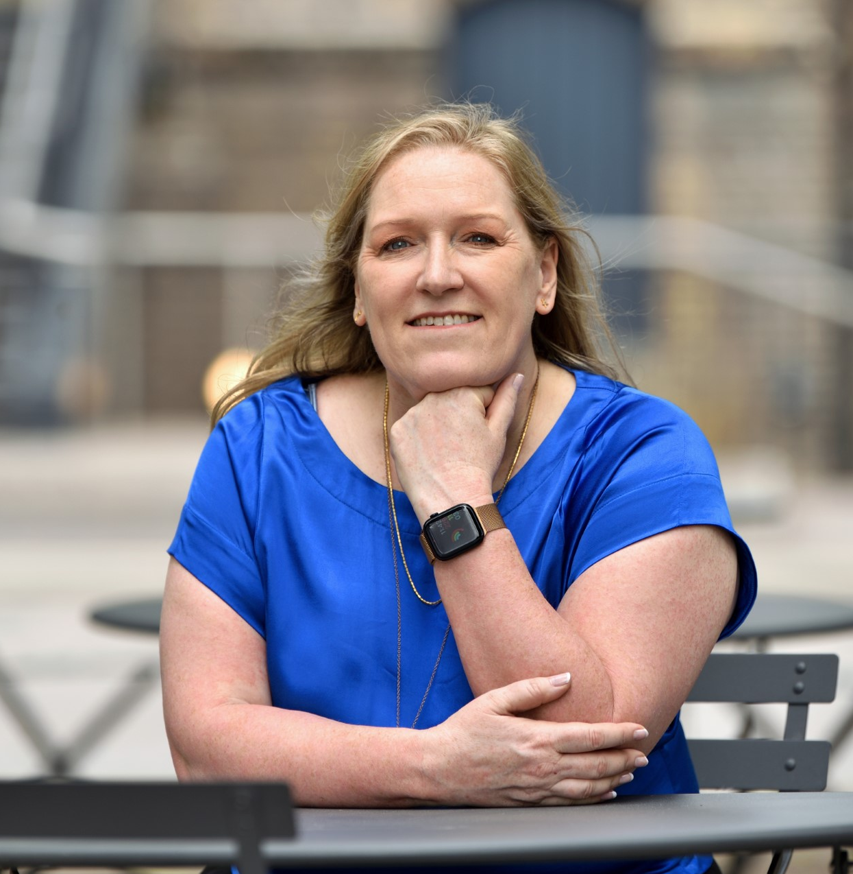
ROSIE RANGANATHAN
Executive Coach
Areas of Expertise
1:1 Executive Coaching
Leadership and Management
Coaching through transition
Career Coaching
Climate Coaching
Empowerment for under-represented groups and introverts
Personal Profile & Background
Rosie is a qualified Executive Coach and is an ACC member of the ICF. She works predominantly one to one with people and is passionate about holding the space for her clients to allow for quality thinking and reflection. Her style is outcome focused so that her clients have a clear sense of how they can continue to develop moving forward.
Rosie has extensive experience of working in HR within a variety of industries. She began her career in the music industry, moving into TV and then high-performance sport. She began to coach and noticed how this transformed the service she was able to provide to internal stakeholders.
She is a retained in-house coach for Coutts Private Bank (part of the Nat West Group) helping to drive a coaching culture and coaching senior leaders. She is also a preferred supplier for UK Sport to coach leaders across the sector.
Rosie builds trust and support with an empathetic and person-centred style which helps people to generate insight and reflections in their thinking. Using a naturally reflective style, she holds space for people to pause and gently nudges them to make changes – even if they are uncomfortable in their comfort zones. She is a master of giving feedback in a way that provides insight and thought for how to change whilst ensuring that she tracks actions and keeps clients focused on goals.
Professional Qualifications, Accreditation and memberships
ILM Level 7 Postgraduate in Executive Coaching and Mentoring
Brain Based Coaching (Neuro Leadership Institute)
Barefoot Executive Coaching
Resilience Engine (AOEC)
Gestalt Coaching Skills (AOEC)
Spotlight Practitioner
Master’s Degree in Sports Leadership
Practitioner in Neuroscience
Clients
Rosie has worked with clients from a variety of industries including:
Finance
Sport
Healthcare
Fintech
Education
Charity
Coaching Assignments
Charity - coaching the CEO on their leadership shadow, building a team and scaling the business.
Banking - Executive Director on their leadership specifically their team and how to delegate and raise their game that would allow him to take a more strategic approach
NHS/Sport - Senior Oral Surgeon transitioning to a career in Sport, career coaching and tackling imposter syndrome.
Banking – coached Director on their leadership style moving from very directive, pace and forceful to more reflection and empathy.
www.emergeuk.com
01329 820580

Slide 14
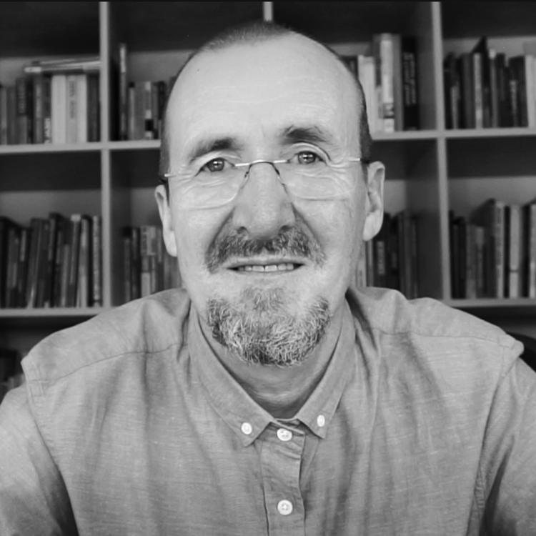
STEPHEN LAMBE
Business Psychology and Executive Coach
Areas of Expertise
Courageous Conversations
Conflict
Promotability
Stress and Anxiety
Presentation
Influencing
Anger management
Coaching
NLP
Emotional Intelligence
Team Building
Personal and Team Resilience
Personal Profile & Background
Stephen is a Chartered Business Psychologist and ILM Certified Executive Coach with over 20 years of experience across sectors focusing on leadership development, training delivery, and executive coaching. Stephen helps people learn by creating an environment where people feel able to explore, make and learn from mistakes, ask questions, laugh and stay curious. Clients have described Stephen as practical, warm and incredibly easy to talk to.
Stephen is especially competent in design and delivery, having managed recruitment processes and designed assessor training during the 6 years in which he worked as a Business Psychologist for the Metropolitan Police.
Stephen’s approach is to be as practical, and outcome focused as possible. His background as a business psychologist and in neuroscience helps you and him to spot and surface some of the underlying themes, competing priorities, motivations, or blockers. His coaching style is unique and adaptable to each client, allowing the space to test new ideas and find out what works for you.
Professional Qualifications, Accreditation and memberships
Chartered Occupational Psychologist – BPS
Level 7 Diploma in Executive Coaching and Mentoring – ILM
Master Practitioner NLP
BPS Certificate of Test Competence Levels A and B
Qualified user of most psychometrics
Advanced Dip Neuroscience of Leadership
MSc. Occupational Psychology
BA Psychology
Coaching Assignments
Courageous Conversations for Social Workers, Managers and Staff in various organisations.
Delivered Leadership and Management programmes for high potential staff in a large housing association and for a worldwide telecommunications company.
Dynamic Interviewing skills for staff facing redundancy in the Civil Service.
Running Assessment and Development Centres in a financial services organisation .
Clients
NHS
Ordnance Survey
Crown Prosecution Service
Cardiff Council
O2
www.emergeuk.com
01329 820580

Slide 15
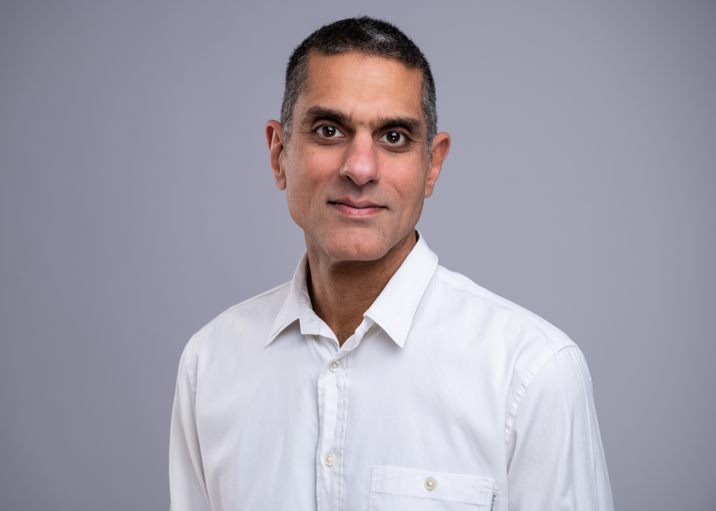
TARIQ
JANMOHAMED
Executive Coach/ Facilitator
Areas of Expertise
Executive Coaching
Team Coaching
Facilitation/ Training Delivery
Leadership
Management
Sales/Business Development
Business Strategy
Business Operations
Personal Profile & Background
Tariq is an executive coach with deep experience in leading company and human transformation. His 25-year career has spanned starting up a mobile phone operator in post-war Afghanistan to executive roles in Google and Expedia Group. He has built, led and coached teams in multiple cultural contexts and is passionate about helping companies and individuals transform to achieve their peak.
Tariq works on the basis that in order to achieve the change you want; you have to balance deep reflection with commitment to action. As a coach, he helps you reflect on who you are, how others see you and the system in which you operate, as well as helping you to take practical steps to ensure your progress. He has been told by his clients that he creates a calm, safe, yet challenging environment for them to do their best thinking and achieve the change they seek.
Professional Qualifications, Accreditation and memberships
MSc. with distinction in Coaching and Behavioural Change - Henley Business School
Professional Certificate in Executive Coaching – Henley Business School
Master of Business Administration (MBA) – The Wharton School, University of Pennsylvania, USA
Associate Certified Coach - International Coach Federation
BSc. in Economics – University of Bristol
Coaching Assignments
NGO – Coaching CEO to adapt leadership behaviours in transition from hands-on executive to advisory role while onboarding new CEO.
Fintech scale up – Managing challenging relationship with co-founder while delivering on execution priorities for critical next funding round.
Technology – Evolving leadership behaviours of a Sales Director having been double promoted from running a small finance team to managing a sales team of over 100 people with significant revenue responsibility.
Clients
Tariq has worked with clients from a variety of industries including:
NGOs
Financial
Technology
www.emergeuk.com
01329 820580

Slide 16
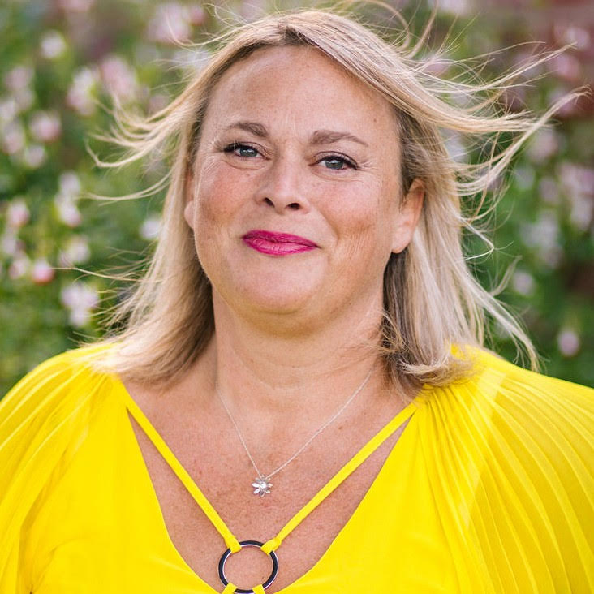
TRUDY SIMMONS
Executive Coach & Facilitator
Areas of Expertise
1:1 Personal Coaching
Executive Coaching.
Business Mentoring and Coaching
Workshop facilitation.
Creating platforms and environments for businesswomen to thrive
Personal Profile & Background
Trudy has lived around the world and actively created conference, networking events and other opportunities for businesswomen to confidently been seen and heard. She started her own business in 2010 in Australia having worked in Corporates for 20 years, mostly in Operational Management roles. Through these roles, she learned the value of people and having the right people in the right role to get the bigger picture achieved. This was accomplished through motivation, enthusiasm, support, appreciation and a good plan. These are the skills that she now brings to her own business and to any coaching, mentoring or training that she runs.
Trudy has coached businesswomen in various and widespread industries across the world.. She appreciates where people are, and where they want to get to, and that sometimes, it is difficult to see the clear path to the outcome. She believes that together, it is possible to create a clear path towards individual and communal betterment.
Trudy’s speciality is being able to actively listen to a problem and facilitate solutions that work for that individual. She is a master of helping busy people to manage pressing demands, self-sustainability and creativity. Her relaxed and humorous persistence helps clients to stay focused on their goals. She is always supportive and empathetic but will give you a gentle nudge to commit to action when required.
Professional Qualifications, Accreditation and memberships
PCC with the International Coaching Federation
Clients
Trudy has worked with clients from a variety of industries, including:
Finance
Marketing
Advertising
Fashion
Education
Real Estate
Coaching Assignments
Advertising Agencies – looking at business models to be able to create passive income streams and clearly communicate with clients.
Accountancy Firm – helping the Director to create clear boundaries with clients and bookkeepers, to efficiently and effectively run the firm
CEO of a large clothing company in USA – help with building confidence and navigating new challenges.
www.emergeuk.com
01329 820580

Slide 17
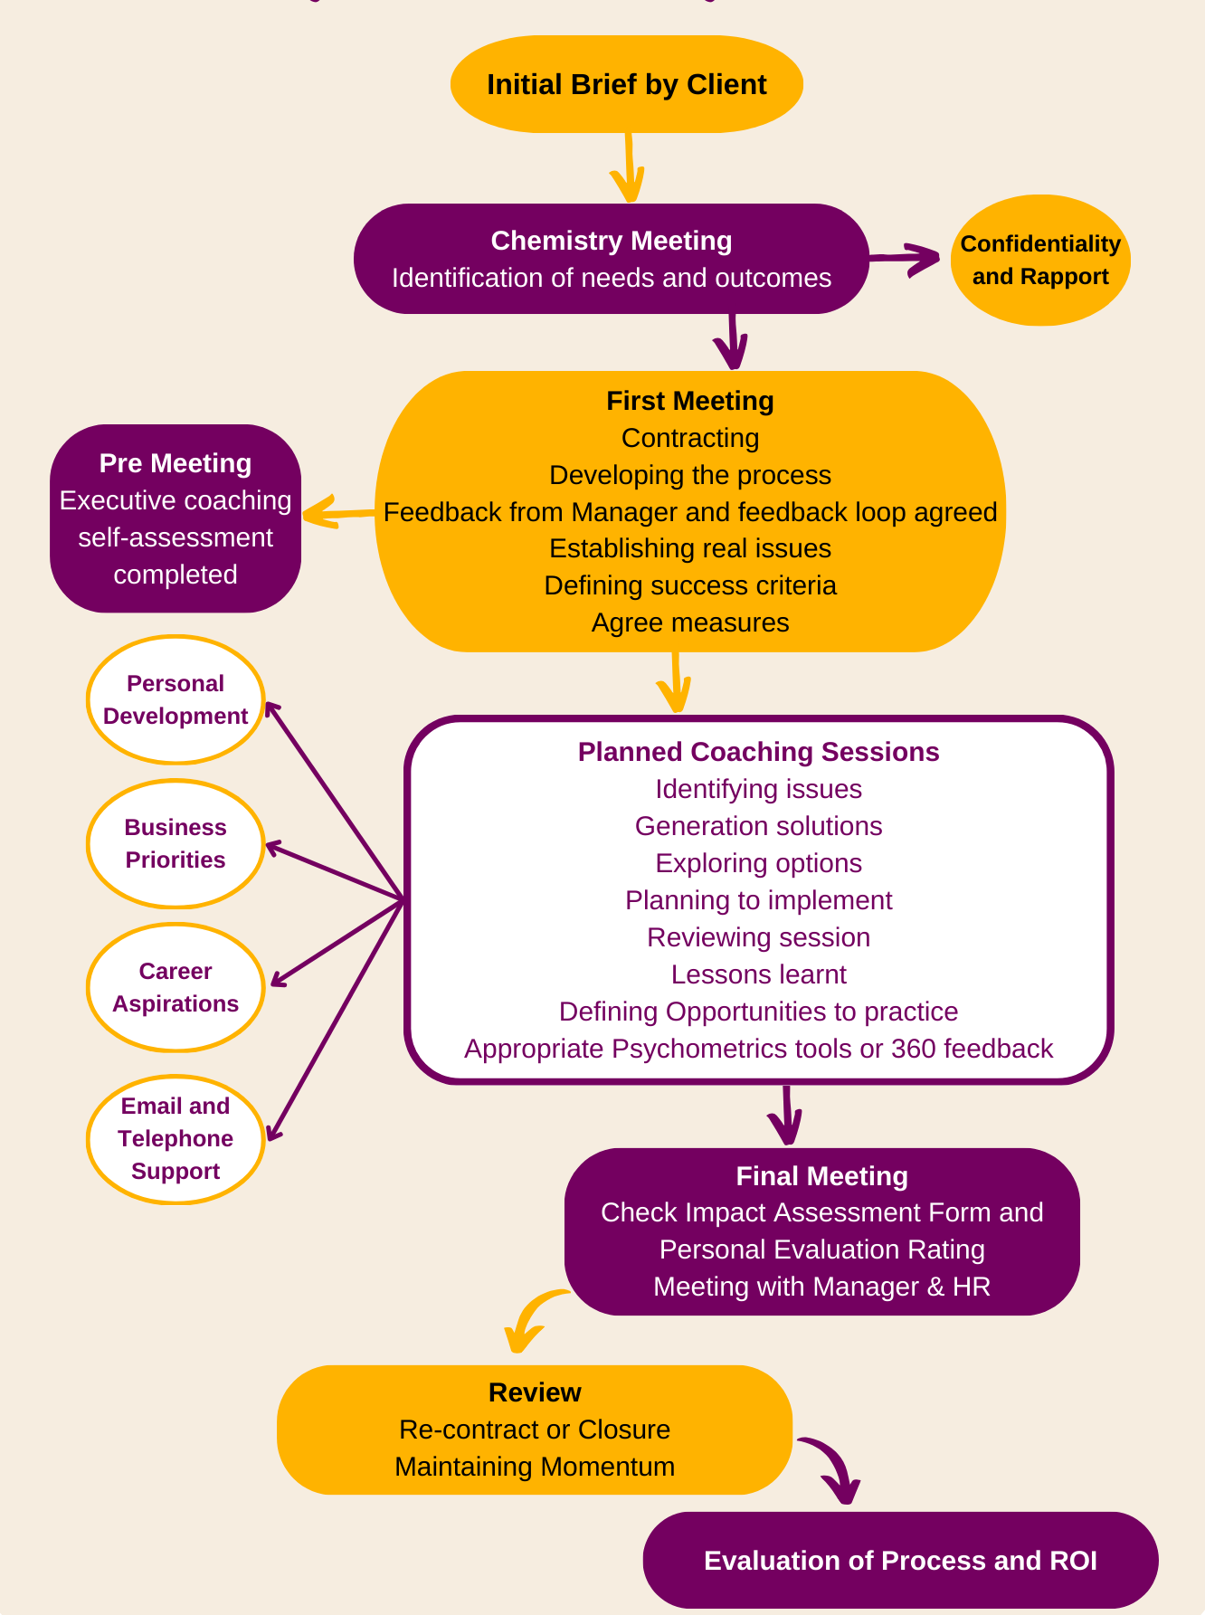
Our Coaching Process

Slide 18
Our Coaching Supervision Process
Supervision
As coaches, pausing, stepping back and engaging in thoughtful reflection is highly valuable, and often something that we deeply appreciate. Coaching supervision creates a supportive environment which encourages new, fresh perspectives and open brainstorming. Whether aiming to enhance coaching methodologies, foster client relationships, explore new tools, or prioritise self-care for optimal coaching performance, regular supervision is paramount. These sessions can be conducted collaboratively or individually to help you to revitalize your focus, recalibrate your efforts and ensure that you deliver exceptional service to your coachees. Acting as a dynamic space for rejuvenation, these sessions ignite innovative ideas and initiatives with the aim of enriching your coaching practice.
Rosie Ranganathan
Rosie is an executive coach, an ACC member registered with the ICF. Her approach to coaching is collaborative and outcome focused. Rosie is passionate about creating a space for her clients to engage in quality thinking and reflection which will help them to achieve a sense of clarity about how they can continue to develop.
Skills and Qualifications
ILM Level 7 Postgraduate in Executive Coaching & Mentoring
Barefoot Accredited Coach Supervisor
Brain Based Coaching (Neuro Leadership Institute)
Barefoot Executive Coaching
Practitioner in Neuroscience
Gestalt Coaching Skills (AOEC)
Spotlight Practitioner
Systemic Coaching
What to expect
As a PCC Executive Coach and accredited Coach Supervisor, Rosie’s approach is centered on maintaining a clear focus on your ultimate goal for the session ensuring that you depart with the clarity and energy necessary to progress. She believes that in contemplating the notion that "who we are is how we coach," it becomes imperative to reflect on how we present ourselves to our clients each day. What steps must be taken to guarantee that we embody the kind of coach we aspire to be?
www.emergeuk.com
01329 820580

Slide 19
Our Coaching Rates
Level | Description | Rate – 90 Minute session per coachee
Level 1 | CEOs and Managing Directors | £800
Level 2 | C-Suite, Executives and Directors | £650
Level 3 | Senior and Management Team | £520
Level 4 | All other employees | £460
Group Coaching | 90 Minute Group Session - 2/3 coachees with the same development requirement | £600
Optional Psychometric Tools Per Coachee
MBTi | £60
Insights | £110
Lumina Spark | £150
SDI | £115
Motivational Maps | £50
DISC | £109
360 | £175
We also offer several psychometric tools to complement our coaching offerings.
www.emergeuk.com
01329 820580

